Slide 1
JAROWA
From startup to scaleup: How we managed the transition

Slide 2
AGENDA
About JAROWA
Which points do we see as success factors?
Q&A

Slide 3
JAROWA‘S CUSTOMERS ARE RENOWNED INSURANCES IN SEVERAL COUNTRIES
JAROWA offers two solutions:
smart contracting for dynamic FNOL & automated coverage checking
cloud platform and marketplace for digital provider- and order management
Modular. Configurable by self-service. Easy to integrate. Usage-based priced.

Slide 4
AGENDA
About JAROWA
Which points do we see as success factors?
Q&A

Slide 5
SUCCESS FACTORS
The success factors were built up step by step
Strong basis
Clear business model & proof points
Involve stakeholders in development & create commitment
Timing & fun
Iterative and consequent development

Slide 6
SUCCESS FACTORS
The success factors were built up step by step
Clear business model & proof points

Slide 7
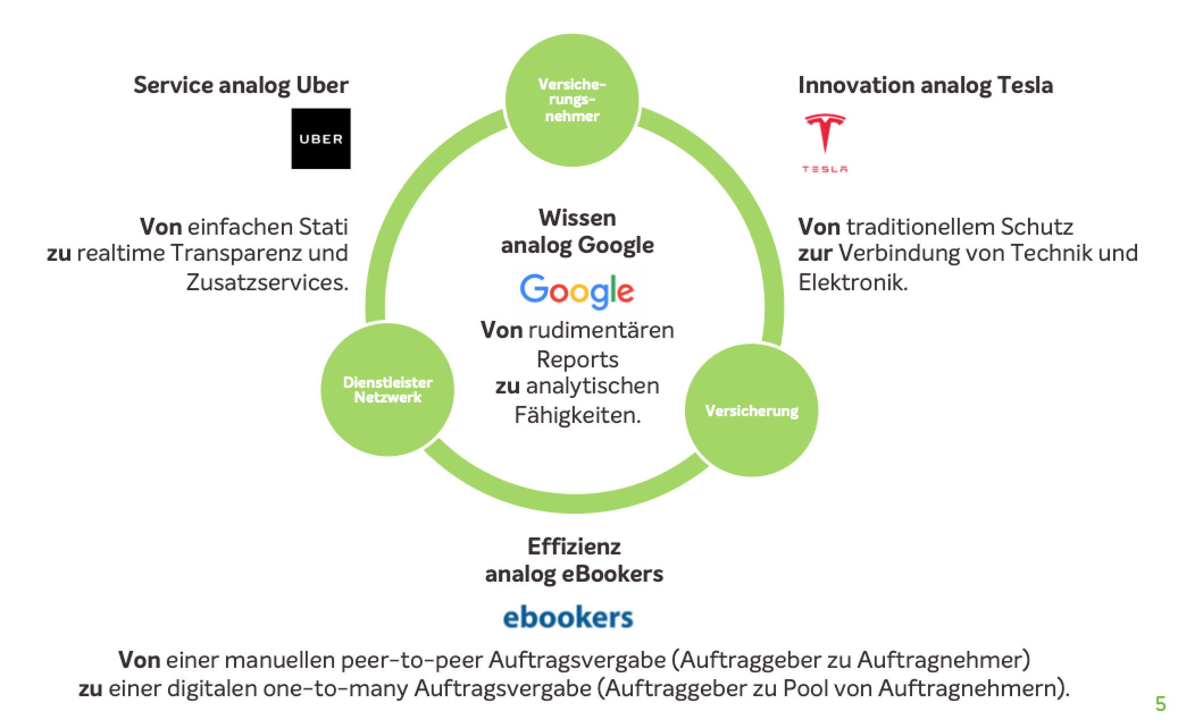
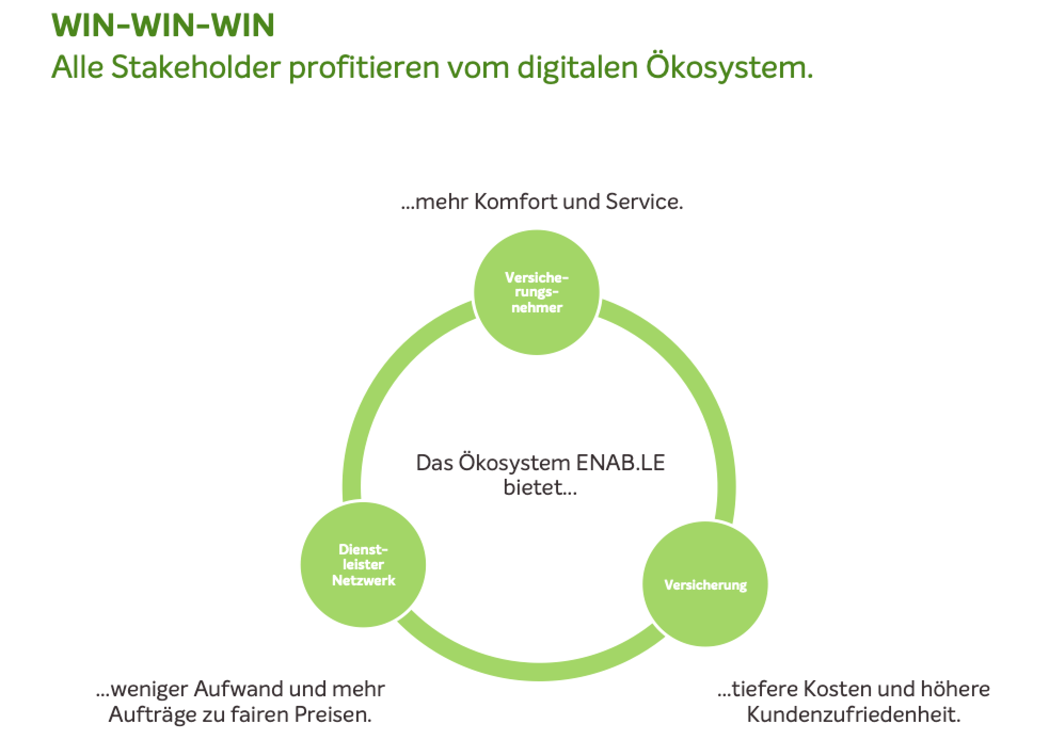
BUSINESS MODELL
Evolutionary steps starting from end 2017

Slide 8
WE CREATE A WIN-WIN-WIN SITUATION FOR ALL PARTIES
Win-Win-Win Situation
All parties profit from clear and measurable benefits
High admin effort, low transparency, inefficient collaboration and no additional services
End- customer
(= service receiver; e.g. insured person, tenant, etc.)
Trusted providers
(e.g. craftsmen, lawyers, doctors, etc.)
Insurance or Property Manager
High comfort, transparency and service
Few traditional reports
Analytics & benchmarks
Low transparency and inefficient mandating process Insurance only: Low steering rates and limited provider selection
High acquisition costs, inefficient collaboration and low standardisation
Minimal effort for new, standardised orders & more orders to a fair price
High coverage, optimised costs and high customer satisfaction
As is situation
Added value with JAROWA

Slide 9
JAROWA’S MODULAR DIGITAL CLAIMS JOURNEY
Systems like…
Others
Solutions integrated in …
Call centre driven
Hybrid A
Hybrid B
Hybrid C
Insured self service
All functionalities can be used via ONE platform.
Functionalities can be activated and deactivated in self-service.
The JAROWA Dashboard can be used standalone or integrated with the claims system.
Claim happened or need for service
Insurer
Insurer
Insured
Insured
Insurer
Insurer
Insurer
Insured
Insured
Insured
Fraud detection
Formal coverage check
Insured login needed
Manual data pasting
Robot
API integration
Manual data pasting
Robot
API integration
Manual data pasting
Robot
API integration
Manual data pasting
Robot
API integration
API integration
Event validation
FNOL & material coverage check
unique link
Cost estimation for settling
Capture damage & final calculation
unique link
Choice how to settle claim
unique link
Mandating of service provider
Bill validation & checking
Bill acceptance
Manual data pasting
Robot
API integration
Manual data pasting
Robot
API integration
Manual data pasting
Robot
API integration
Manual data pasting
Robot
API integration
API integration
Payment of claim

Slide 10
SUCCESS FACTORS
The success factors were built up step by step
Strong basis
Clear business model & proof points

Slide 11
STRONG BASIS: TEAM
The team evolves over time and needed capabilities change as well
Team
Founders / Executive Board
→ Covering various functions and Network
Board of Directors
→ Credibility and Network
Team
→ To develop according capabilities need

Slide 12
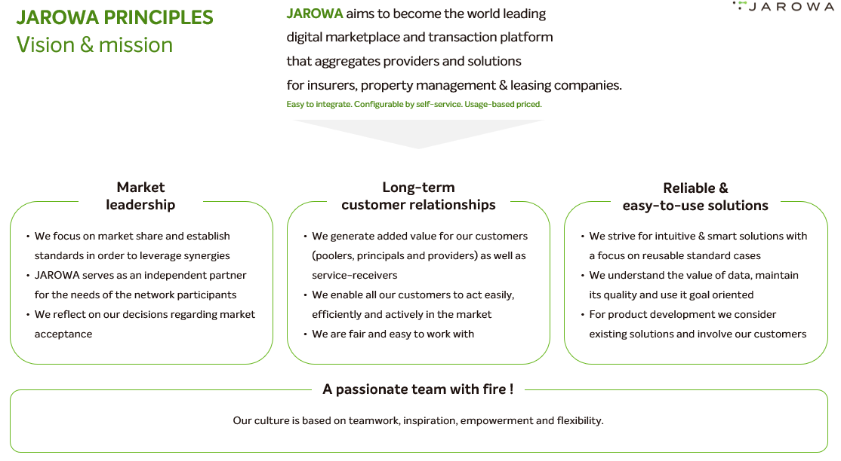
STRONG BASIS: IDENTITY & VALUES
Important to make decisions (especially in the absence of processes)
Identity & values

Slide 13
STRONG BASIS: GOVERNANCE
Clearly define the areas to be governed and where to maintain feedom
Governance
Legal contracts
Data security
IT security

Slide 14
STRONG BASIS: STABILITY
Stability is an essential factor internally, but also towards the customers
Stability
Financial stability:
Company Liquidity → critical path
Personal financial situation
Technical stability & reliability
Team stability:
Shareholding
New Work

Slide 15
SUCCESS FACTORS
The success factors were built up step by step
Strong basis
Clear business model & proof points
Involve stakeholders in development & create commitment

Slide 16
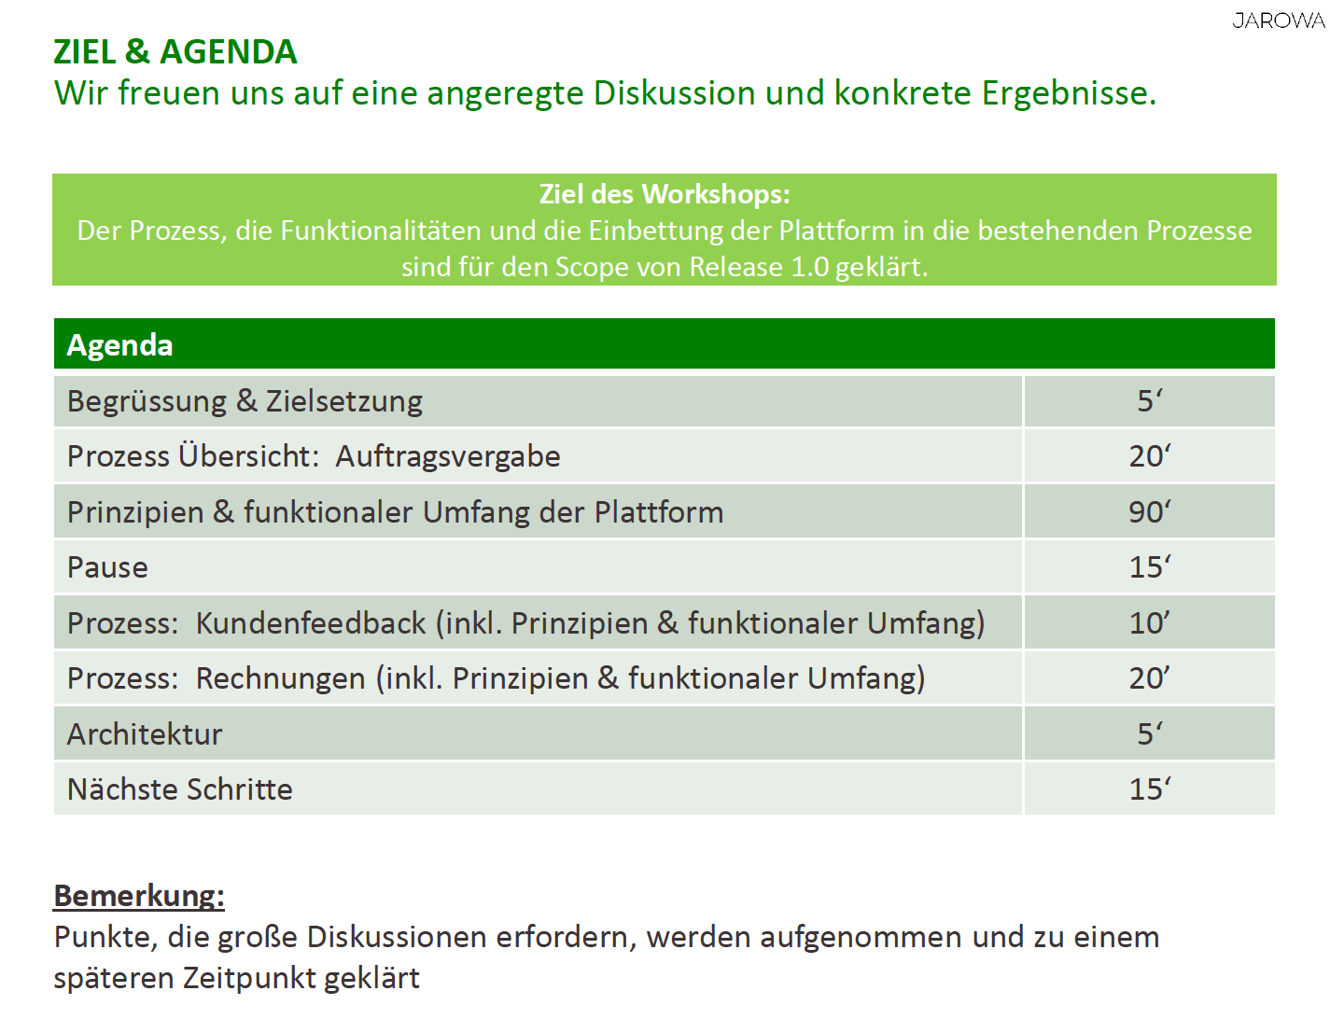
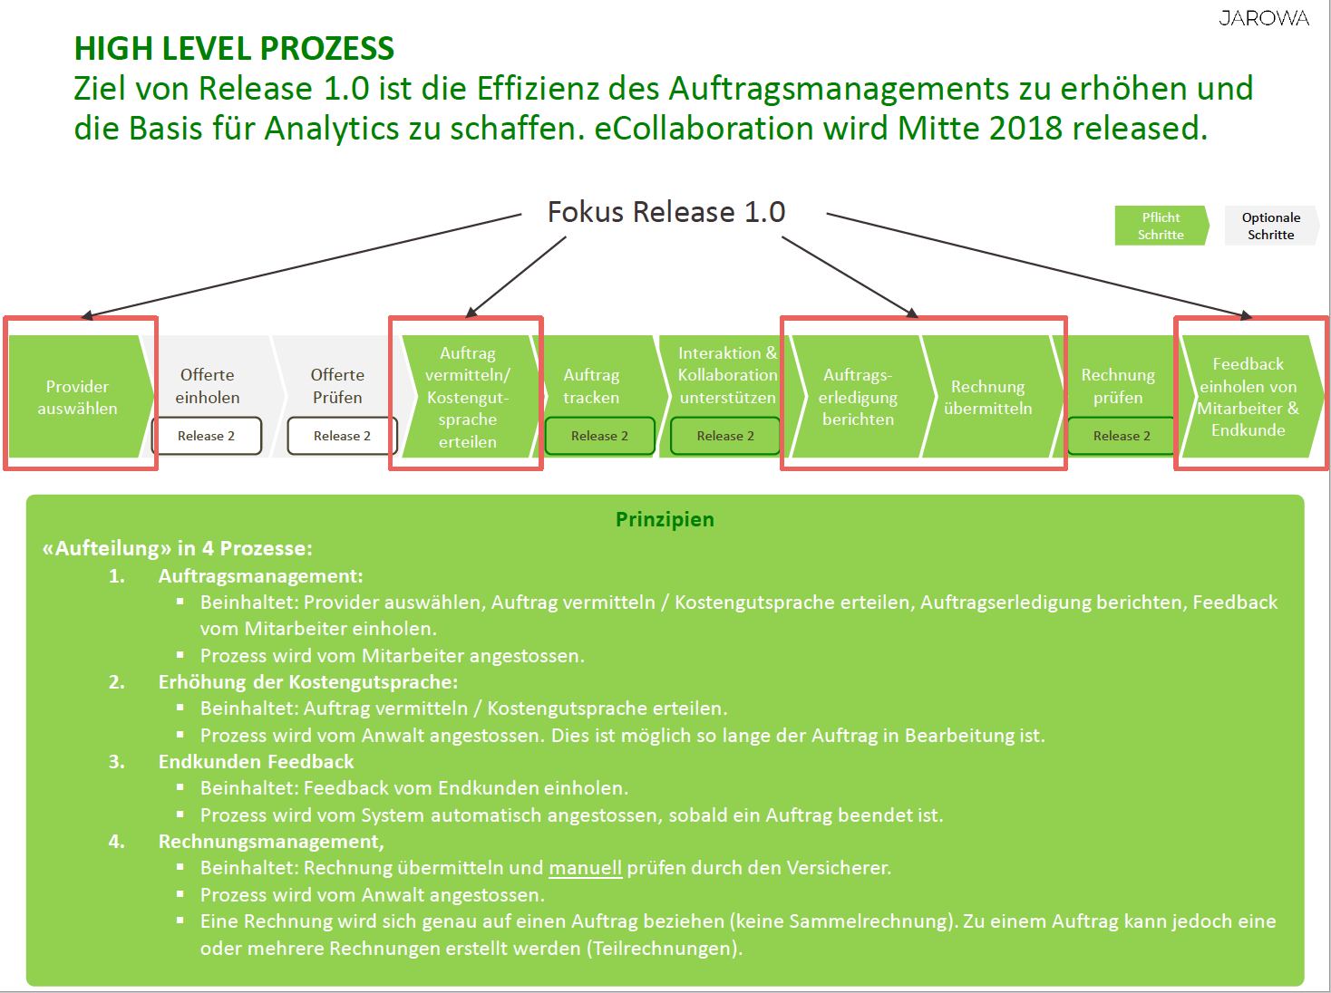
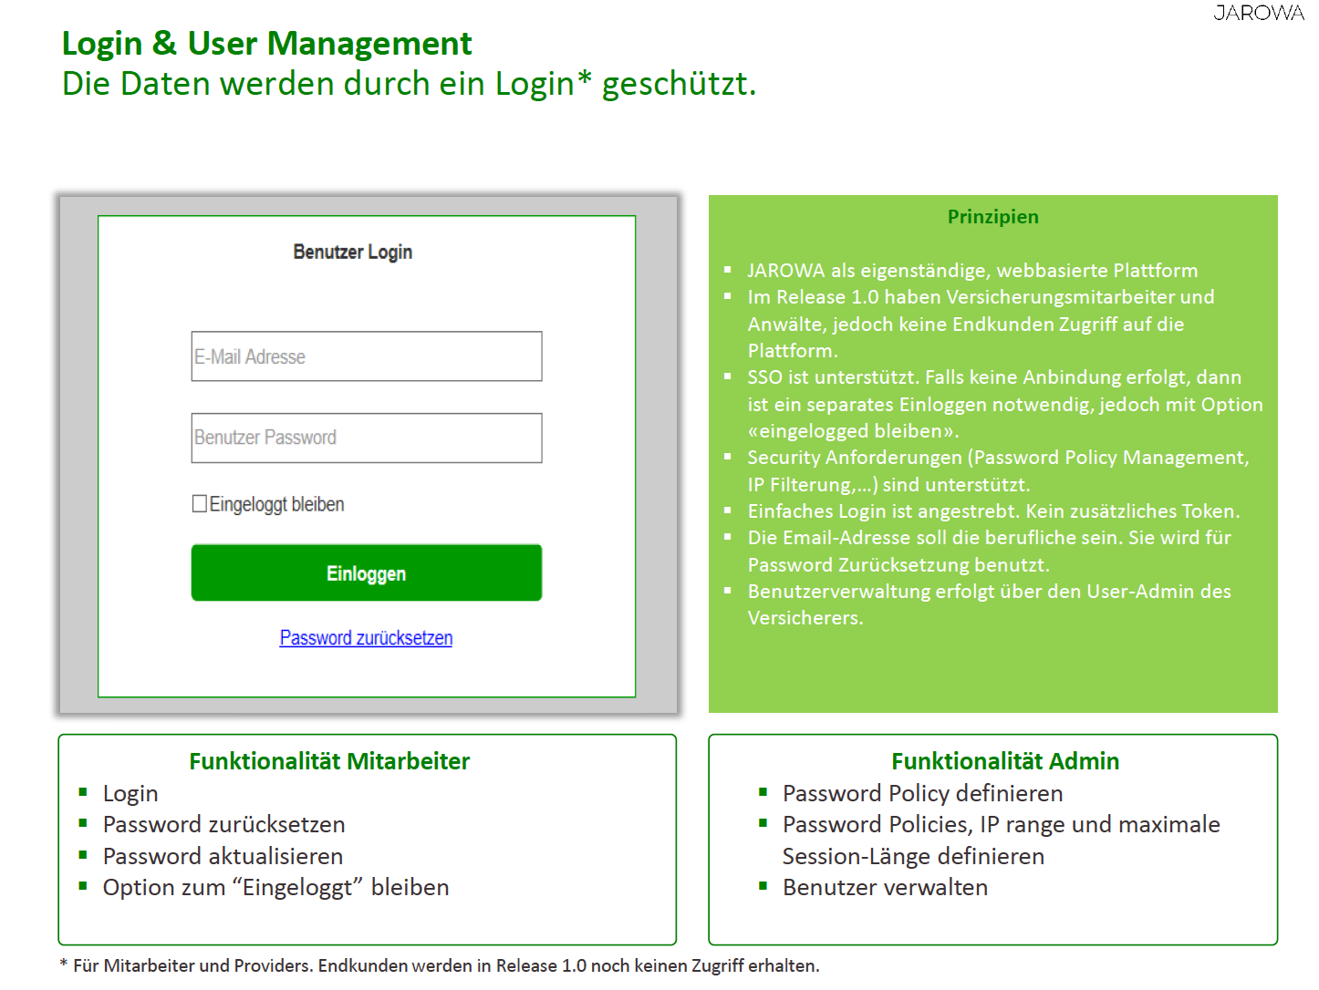
INVOLVING USERS IN DEVELOPMENT
And structure the workshops well...

Slide 17
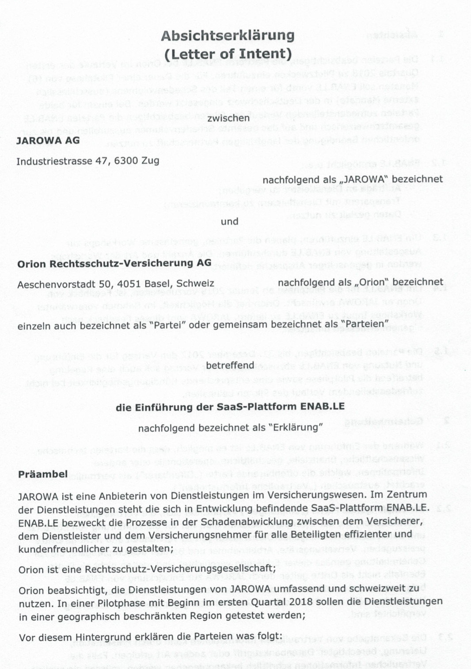
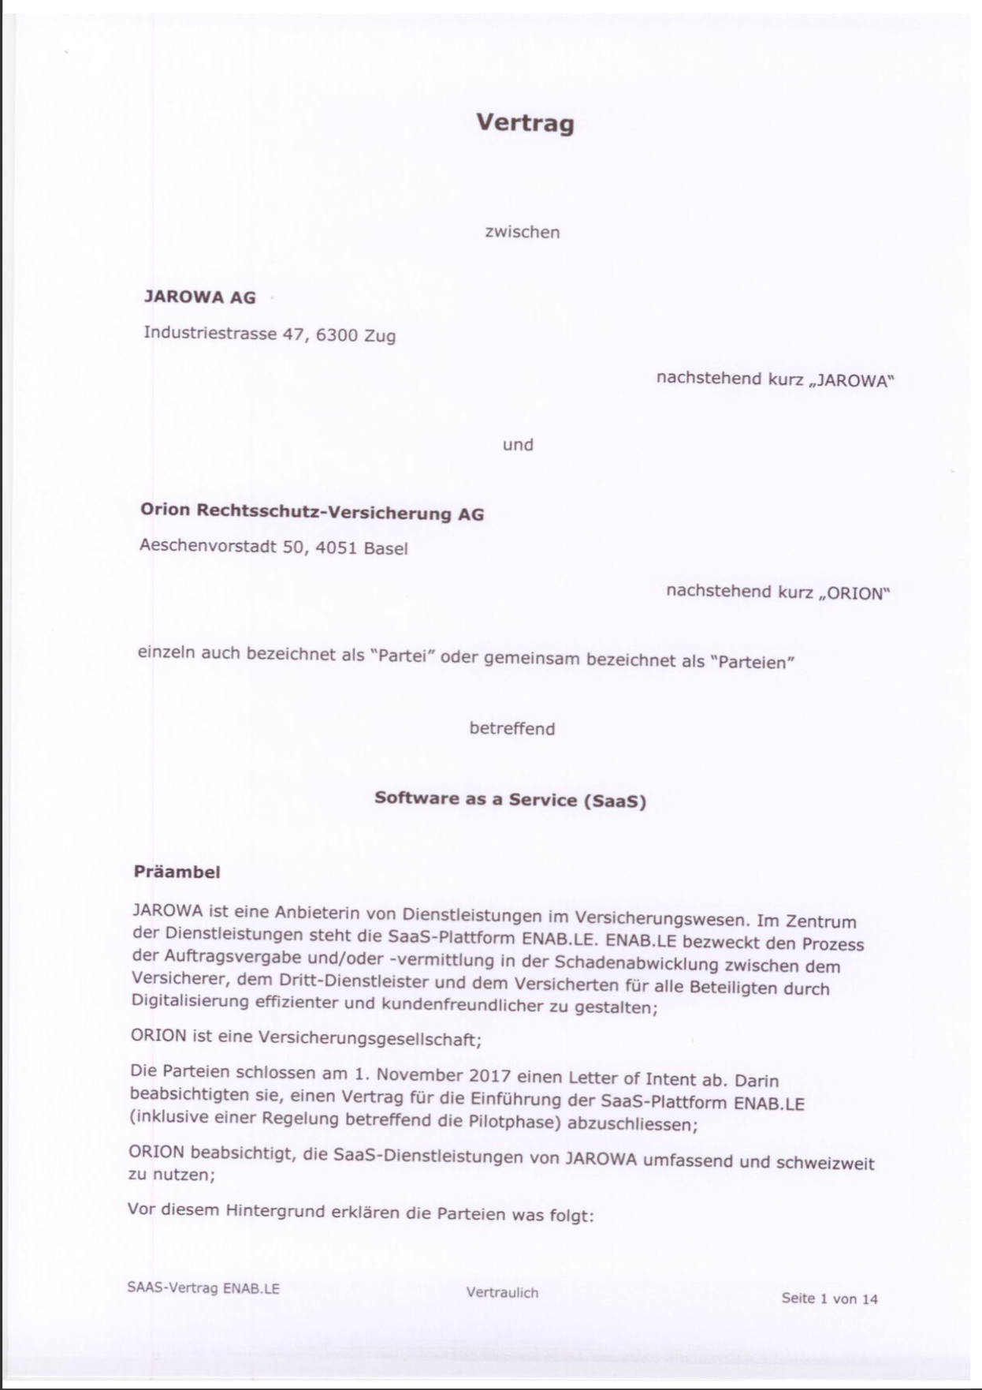
CREATE COMMITMENT
Convincing decision-makers for the pilot, setting goals and obligations ...

Slide 18
SUCCESS FACTORS
The success factors were built up step by step
Strong basis
Clear business model & proof points
Involve stakeholders in development & create commitment
Iterative and consequent development

Slide 19
Iterative and consequent development
Approx. 2/3 of the budget is invested in further development.
New services are added.
Existing services are continuously improved. → Super User Calls and Steering Committees implemented
Customers and partners are technically integrated.

Slide 20
SUCCESS FACTORS
The success factors were built up step by step
Strong basis
Clear business model & proof points
Involve stakeholders in development & create commitment
Timing & fun
Iterative and consequent development

Slide 21
RELATIONSHIP MANAGEMENT & APPRECIATION
The customer should enjoy working with us...

Slide 22
SUCCESS FACTORS
The success factors were built up step by step
Strong basis
Clear business model & proof points
Involve stakeholders in development & create commitment
Timing & fun
Iterative and consequent development
The factors above support each other. The goal is to create a continuous upward spiral.

Slide 23
AGENDA
About JAROWA
Which points do we see as success factors?
Q&A

Slide 24
Christian Akeret
christian.akeret@jarowa.ch
+41 79 676 11 74
www.jarowa.group

